Slide 1

Lil Pudgys Social
Growth Proposal
Prepared by Toto

Slide 2
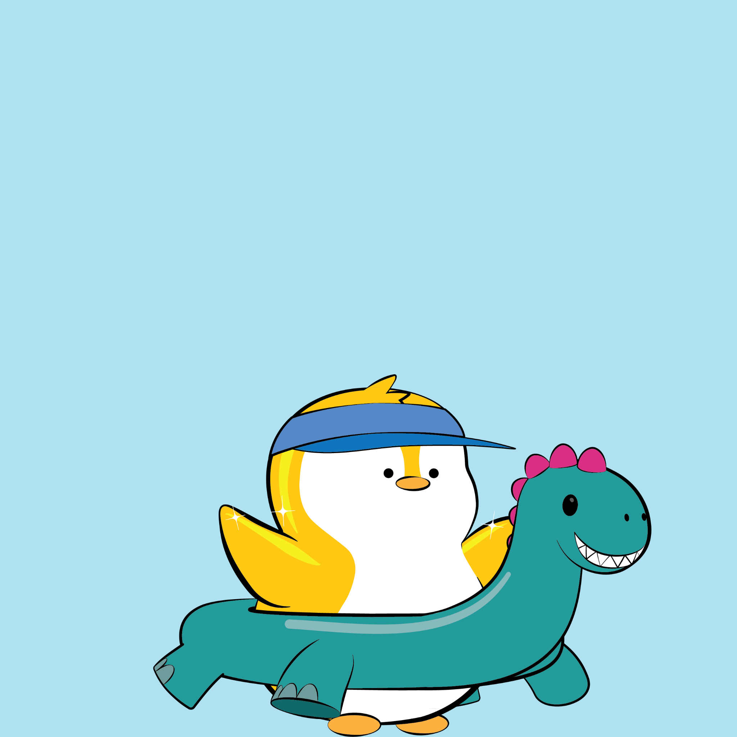
Who am I?
Product-focused engineer, passionate about building experiences that make an impact. I bring ideas to life : translating concepts into products & brands people actually enjoy.
💡 I blend software craftsmanship with strategic product thinking & marketing, ensuring technical solutions align with business goals and user needs.

Slide 3

Why I Care
01
I’m deeply invested in Lil Pudgys’ long-term success.
02
Experience scaling channels from 0 → 6K and 5M+ views.
03
I believe Lil Pudgys can thrive in web2, generating metrics that boost web3 storytelling and marketing.

Slide 4

Executive Summary
Lil Pudgys has strong creative foundations but low platform traction.
Goal: Build a scalable growth engine for YouTube + TikTok.
Main issues: unclear audience, weak discoverability, misaligned formats.

Slide 5
The Goal
01
02
03
Grow channel visibility and algorithm alignment
Establish Lil Pudgys
as a recognizable animated brand
Increase engagement, retention, and audience clarity

Slide 6
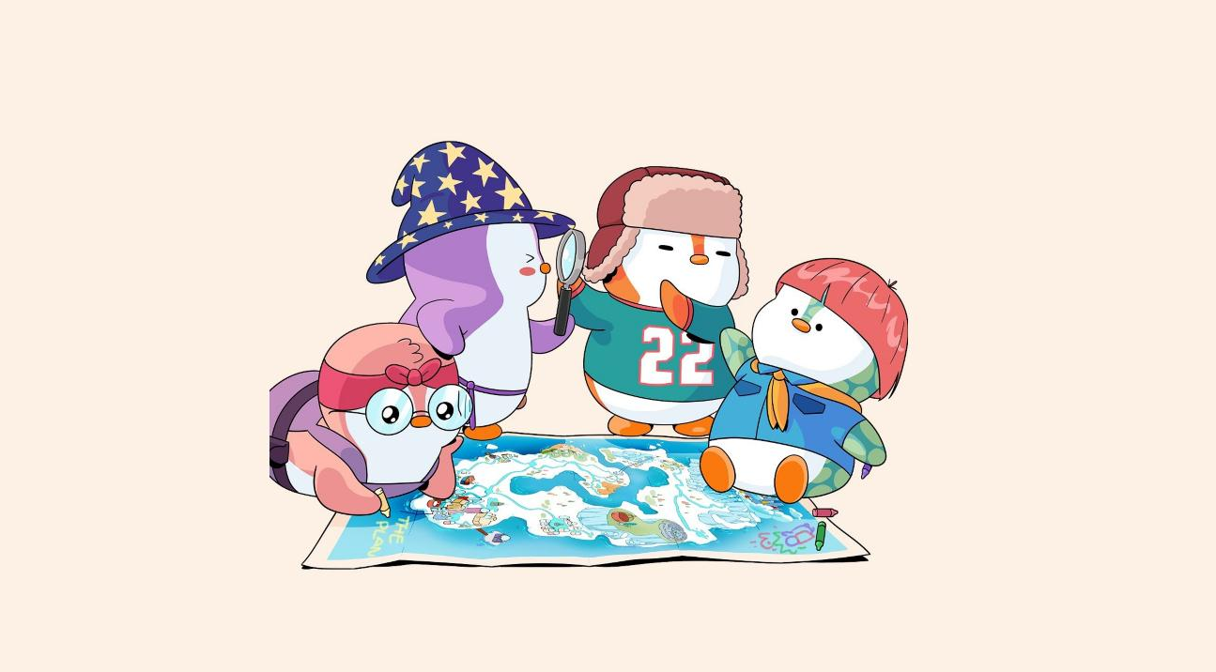
What’s Working
Strong visual identity and character charm.
High-quality, appealing animation.

Slide 7

The Core Problem
THE WHO
The Algorithm cannot determine a target audience
Because
• Mismatched audience design leads to weak retention
• Tags, titles, and descriptions misaligned with viewer intent
• Low engagement loops weaken visibility
• Storytelling misaligns with audience

Slide 8

How Audiences Consume
Kids (1–6):
Longform, Compilations, YouTube Kids.
Kids (7–13):
Short-form, YouTube/Tik Tok Kids.
Teens (13–17):
Short-form, pacing matters.
Adults (18–35):
Relatable micro-humor + short-form.
Sources: Audience Viewing

Slide 9

Short-form is universal;
design for it from the start, not as an afterthought.

Slide 10
The Result
01
More cost-efficient: one longform budget can produce several short-form pieces
02
Easier iteration; feedback can be applied quickly using engagement metrics
03
Short-form-first creation supports Tik Tok ↔ YouTube funneling

Slide 11

The Problem 2: Discoverability
• Misaligned tags & metadata confuse algorithms
• No clear funnels guiding viewers to core content
Brand recognition outside crypto is limited; new content funnels
are needed to drive broader audiences to the channel.

Slide 12
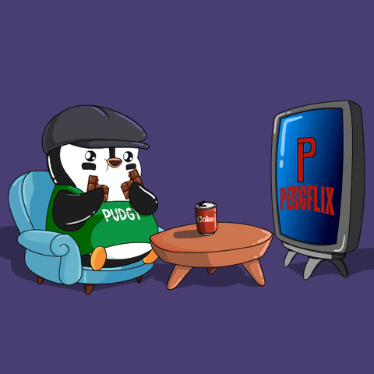
Strategic growth requires placing Lil Pudgys directly
in the audience’s attention stream.

Slide 13

The Problem 3: Engagement
Brand currently sees low interaction
(comments, shares, likes) relative to output & quality

Slide 14

The Formula is the same
Just Like X: Consistency, CTA’s and Intern
These boost video metrics fueling the algorithm

Slide 15
Content Pipeline Framework
02 - Ideate
01 - Optimize
Create script with specific goals in mind
Adjust new videos pacing & script based off metrics
How content should be produced
03 - Produce
05 - Publish
Animate, Edit videos with Platforms in mind
Upload videos utilizing platform specific best practices & feedback
04 - Analyze
Review video engagement & retention metrics

Slide 16
Expected Outcomes
01
02
03
04
Higher early traction on new uploads.
Improved retention and CTR.
Clear algorithmic placement & audience recognition.
A sustainable growth engine built on iteration.

Slide 17

Execution Framework

Slide 18
Define Target Audience & Goals
01
02
03
Identify primary Target Audience
Define the primary Goal of the channel (brand awareness, merch sales, game adoption)
Once defined, Ensure all creative & distribution decisions align with this north star

Slide 19
Discoverability Improvements
01
02
03
Use high-signal Tags
e.g #cartoons #animation
Rewrite titles / descriptions to target demographic
Re-enable Shorts -> Longform linking

Slide 20
Paid Growth Plan
01
02
03
Test $20-$30 weekly Youtube and Tik Tok boosts
Boost high-retention Shorts
Use ads for exposure, not conversions

Slide 21
Refine Feedback Loop
01
02
03
Identify system processes that changed leading to viewership decline
Use audience comments, watch-time data and retention analytics to guide iterative improvements
Adjust creative direction based off measurable learnings

Slide 22

Thanks
Prepared by Toto

